Slide 1

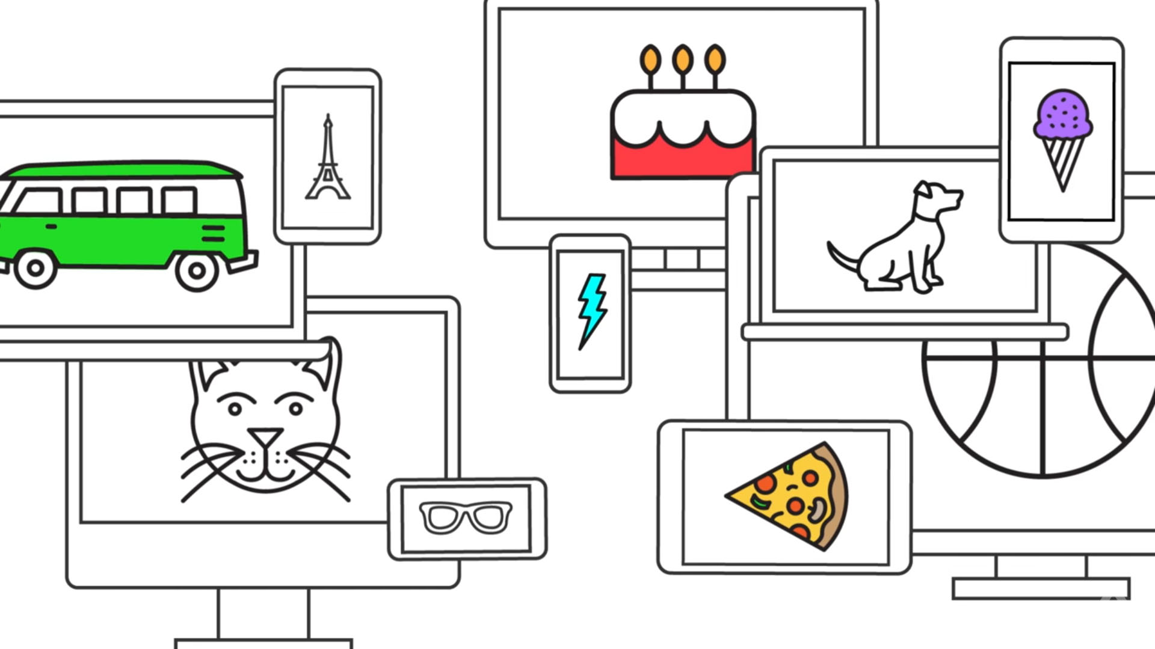
AUTODRAW
GOOGLE’S AI DOODLE BOT

Slide 2
Outline
WHAT IS AUTODRAW?
WHAT IS THE TECHNOLOGY BEHIND IT?
OTHER AI AND THE ART WORLD
DISCUSSION

Slide 3
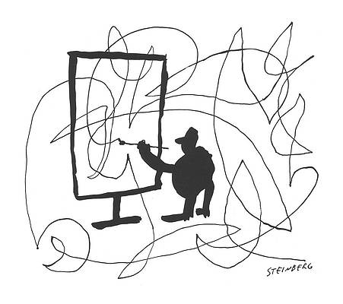

WEB-BASED DRAWING TOOL
MACHINE LEARNING AND DRAWINGS FROM ARTISTS
CREATE RECOGNIZABLE IMAGES, FAST
Identifies an object
Pairs with a database of drawings
Returns neat and simplistic hand-drawn images
AUTODRAW

Slide 4
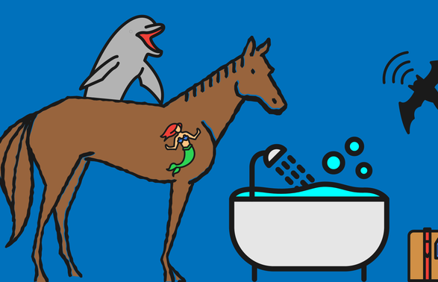
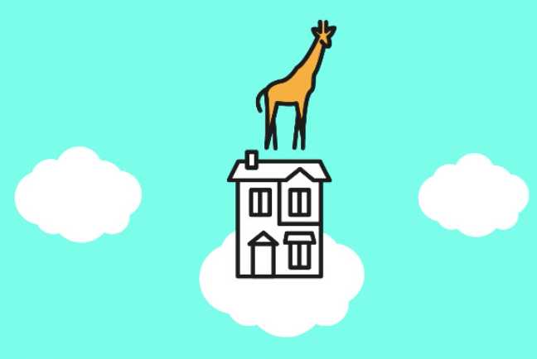

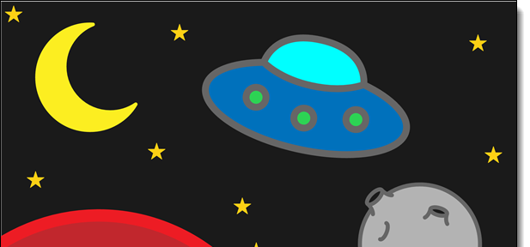

Slide 5
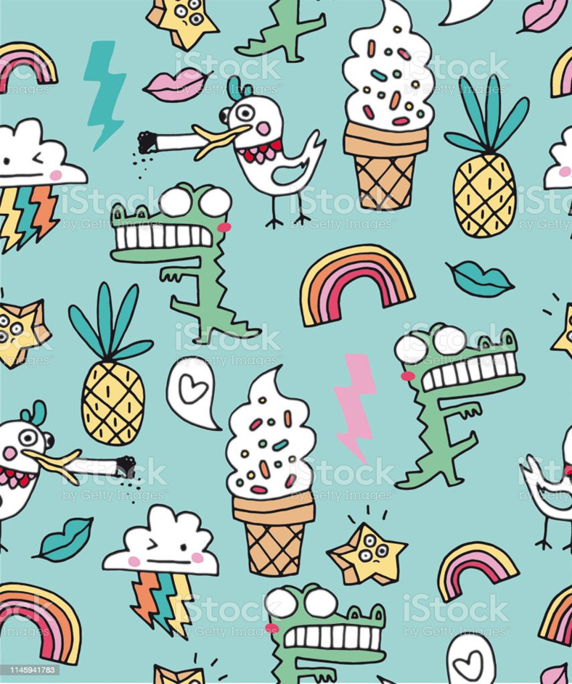
AUTODRAW - TECHNOLOGY
GOOGLE’S AI EXPERIMENTS - IMAGE RECOGNITION
Quick, Draw!
Sketch RNN
Handwriting with a neural net

Slide 6
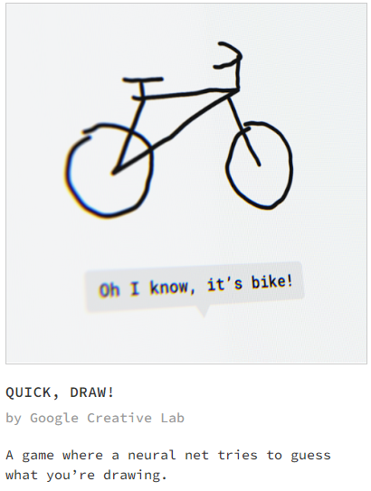
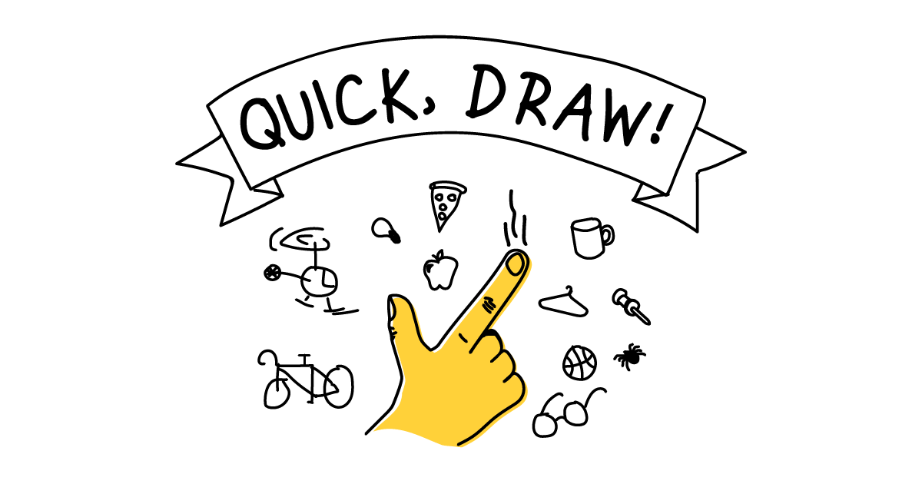
QUICK, DRAW!
Google online game;
Neural network to guess drawings and learn from them;
Over 15M players and millions of drawings;
Biggest open-source drawing set in the world;
Help train new neural networks, see patterns in how people around the world draw, and create new things.

Slide 7
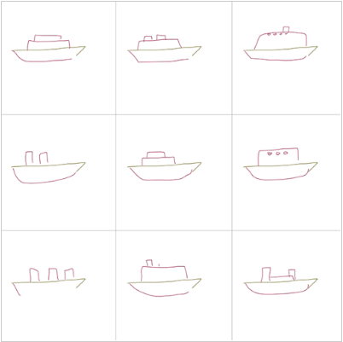
SKETCH RNN DEMOS
Interactive web experiment;
Draw together with a RNN model;
Recurrent neural network relies on temporal sequence to construct stroke-based drawings;
Trained on doodles collected from Quick, Draw!;
Start doodling an object, it will come up with possible ways to continue;
It is also able to morph from one drawing to another;
Drawing differently from the predictions can help with the process for novelty.

Slide 8
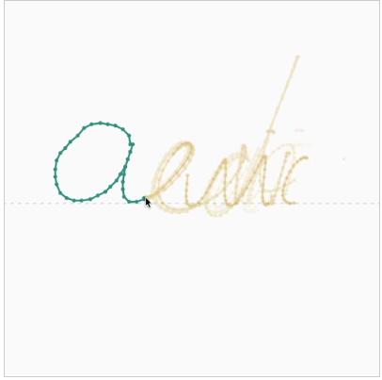
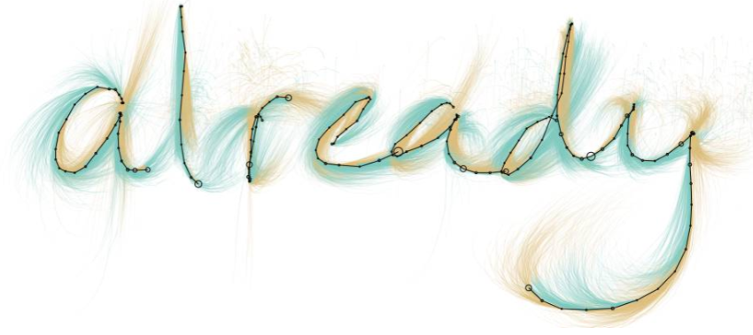
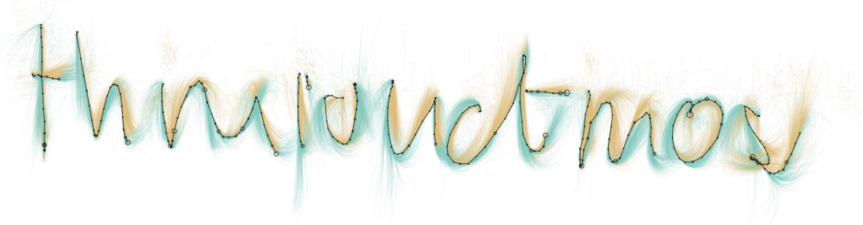
HANDWRITING
Series of AI experiments;
LSTM model: mechanism for remembering previous strokes or letters;
Generating new strokes based on your handwriting input;
Gibberish letters and words that look like real handwriting;
Useful for exploring visualization techniques;
Reading postal addresses, forms; digitization, image restoration for digital libraries:

Slide 9
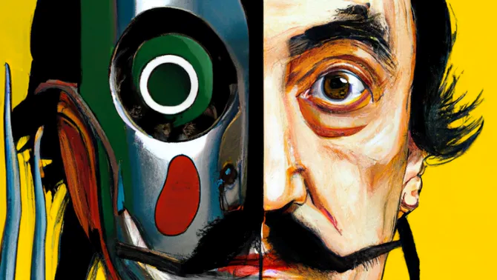
DALL-E
DALL-E 1 AND 2: San Francisco-based OpenAI research lab;
Study existing images, labeled with a text description explaining the person, animal or object
Ability to draw realistic and creative pictures from a mere text description;
Edit existing photos by replacing the imagery inside;
Look at an original image and create different variations of it;

Slide 10
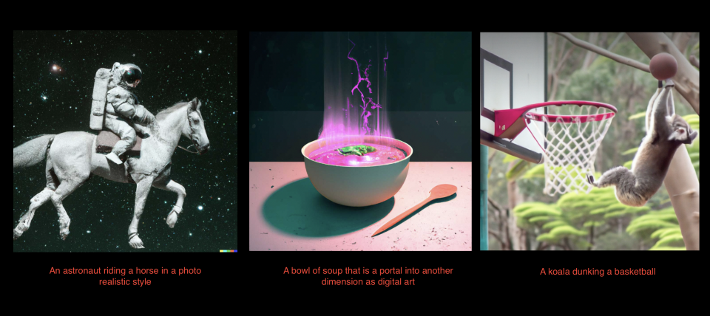
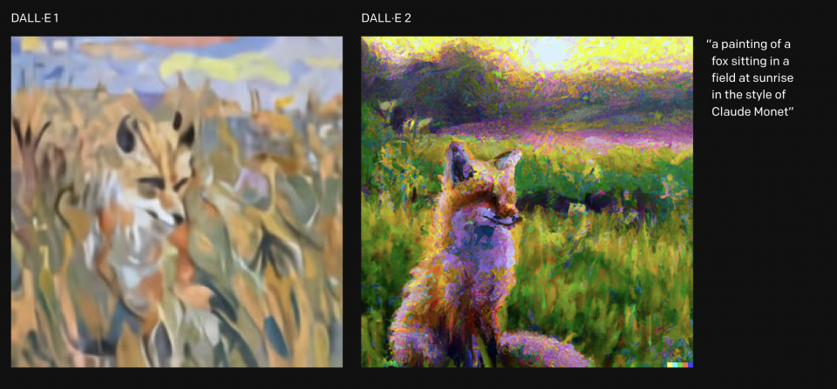

Slide 11
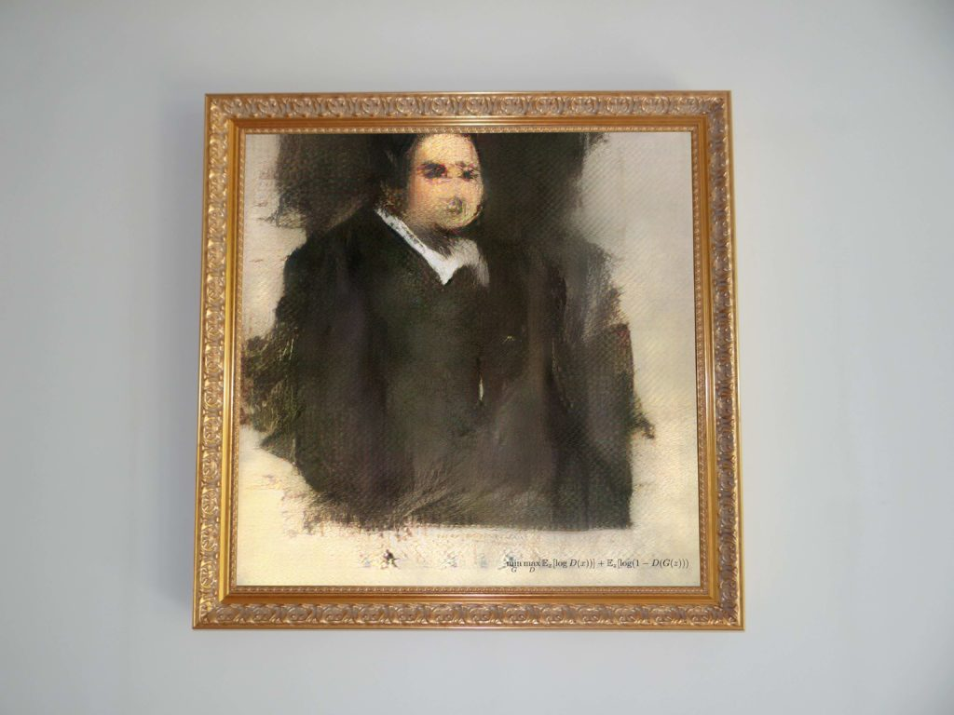
AI AND THE ART WORLD
Christie’s announced the first auction of an AI artwork, with a price estimate of $7,000 to $10,000;
AI created by a French art collective called Obvious;
-GAN: “generative adversarial network”;
-Trained to produce completely new and different images with little human interference.
PORTRAIT OF EDMOND DE BELAMY (2018)

Slide 12
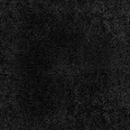
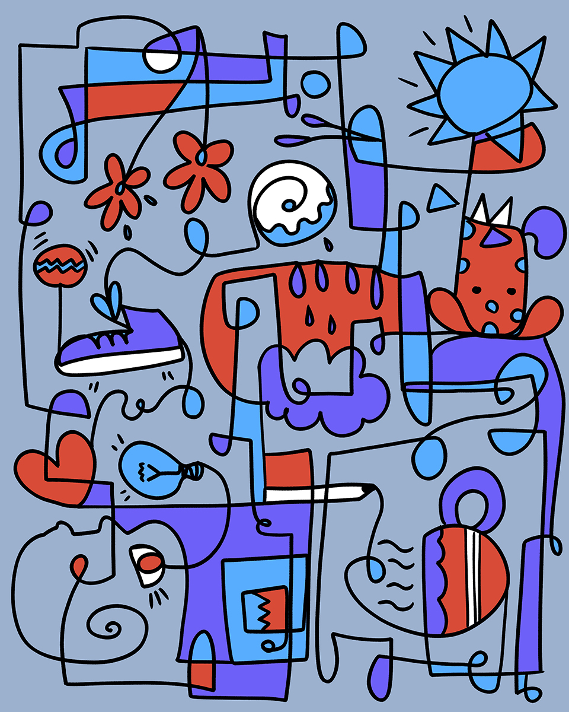
Discussion
WOULD YOU USE ANY OF THESE TOOLS?
CAN THESE TOOLS INSPIRE ARTISTS OR EVEN REPLACE HUMAN ART?
WHAT ARE THE DOWNSIDES OF THESE KINDS OF AI?

